Slide 1
Advance Internship@Clevered Personal Budget Finance App
App User Manual
Author: Ayesha Abdul Qadir

Slide 2
Table of Contents
Acknowledgements
About Me
About My Internship with Clevered
How do I use the app?
Options
Contacts

Slide 3
Acknowledgements
A small vote of thanks for all people who have helped me in this journey of my App Development - My parents, Mr Ken, and My Group members.

Slide 4
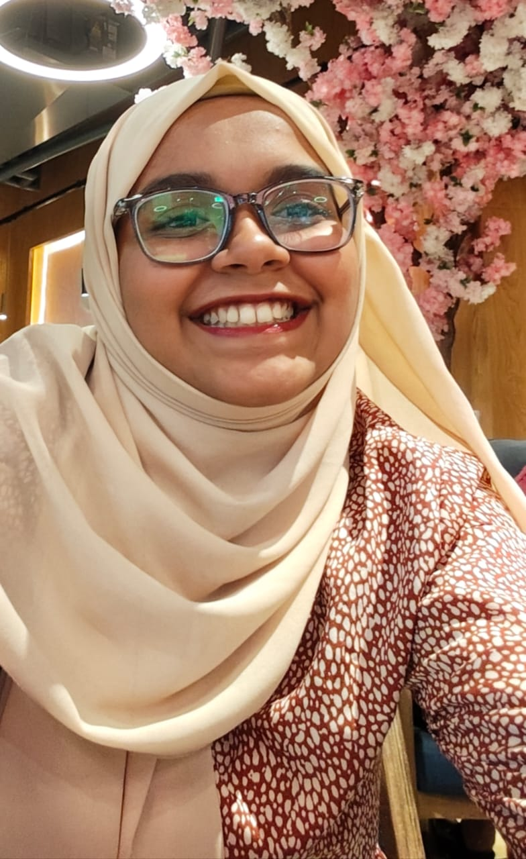
About Me..
Student’s Photograph
My name is Ayesha Abdul Qadir. I'm studying in grade 12, Alpha college. I am currently doing As level. In the future I would either like to pursue Al or software engineering. My interests are reading, painting, designing, and listening to music.

Slide 5
About My Internship with Clevered..
My experience with clevered was a very amazing and

Slide 6
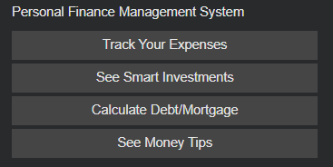
About App..
App’s Main Menu
I made this app by analysing the problems in my community and in my perspective, building this personal finance management app is important because it is difficult for many people to manage money effectively in today's world. We often spend without realizing where our money goes, and traditional budgeting methods can feel complicated or time-consuming. Many people struggle with where to invest or how much to put into savings, this can give them that help.

Slide 7
How do I use the App?

Slide 8
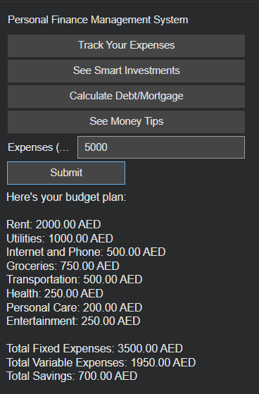
Track your expenses
You just have calculate your expenses and enter your expenses and its helps you budget better.

Slide 9
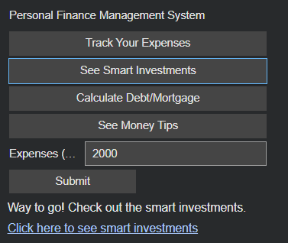
See smart investments
Screenshot/ Pic of each option/screen of the App
It suggests you to invest in stock if you have a good budget remaining after your expenses

Slide 10
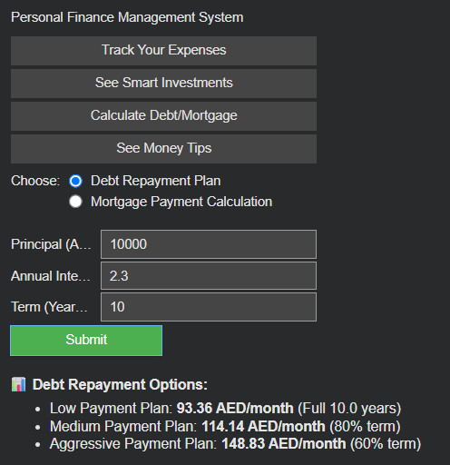
Calculate debt/morgage
It takes your principle and annual interest rate and the number of years you want to pay for and gives you the minimum payment to pay along with more faster methods of paying.
Screenshot/ Pic of each option/screen of the App

Slide 11
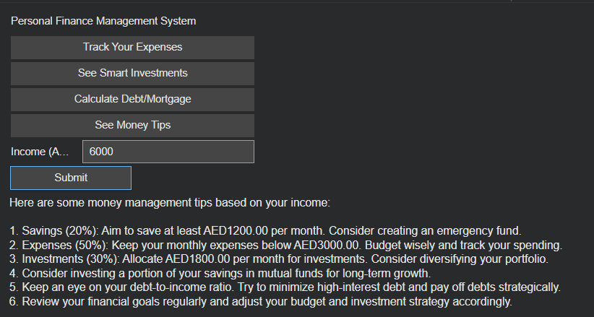
Money tips
Screenshot/ Pic of each option/screen of the App
It takes your income and suggests healthy proportions of savings, expenses, investments. Along with suggesting tips on how to pay down your debt faster and other money tips

Slide 12
Contact Person
Please reach out to student name at ayesha.a.qadir2008@gmail.com for any questions/ concerns/ suggestions on the App

Slide 13
Thank you!

